Slide 1
Lectures 20-21 Ethics in data science
Adam Smith
BU Computer Science

Slide 2
Outline
These two lectures
More questions than answers
Lesson: you do not work in a vacuum
What you do will change the world (for better or worse)
General principles of data ethics
human-subjects research
Informed consent
Do no harm
Limited use
Commercial application
Relevant bodies of law
Privacy law
Civil rights and anti-discrimination
Transparency and accountability
What types of decisions might soon be automated?
How do we know why a model makes particular decisions?
What does it mean to “review and algorithm”?
Open source code
Layperson-interpretable description?
Privacy
What do outputs of data analysis reveal about inputs?
How do we understand what gets collected?
Fairness
Ownership and profit
Whose data is it?
What is informed consent?
Gameability of models

Slide 3
This unit: two lectures
A range of ethical questions tied to large-scale data analysis
General principles
Transparency & accountability
Privacy & surveillance
“Fairness”
More questions than answers

Slide 4
Where are data being used?
Decisions increasingly automated…
Loans
Employment
Self-driving cars
Sentencing and bail
Policing
Romantic relationships
Civil society

Slide 5
You do not work in a vacuum
The work you do as a computer scientist or data analyst changes the world
For better or for worse
Your responsibility: Think about the effects of your work
Engineering has focused on responsibility for years
Obvious why engineering of physical systems matters
Bridges, cars, airplanes, factories
Digital systems are now just as important
https://www.acm.org/about-acm/acm-code-of-ethics-and-professional-conduct

Slide 6
Some general principles
“Human-subject” data = data about people
Well-established guidelines for human subject research
Informed consent
Do no harm
Limited use
Commercial settings
Fewer guidelines
A few relevant bodies of law
Privacy
Anti-discrimination and civil rights
In general
Laws, regulations, guidelines lag years behind problems
Use your judgement

Slide 7
Transparency and accountability
What does it mean for algorithmic decisions to be accountable?
Starting point: Five principles
Responsibility
A “person” (human/organization) should take responsibility
Explainability
What variables played important roles?
Accuracy
It should be measured
Auditability
Third party access should be possible (e.g. via open source code)
Fairness
We’ll come back to this one
Source: Diakopolous & Friedler
https://www.technologyreview.com/s/602933/how-to-hold-algorithms-accountable/

Slide 8
Privacy
What does it mean to handle sensitive data responsibly?
Key aspects
Security
Restrict access to authorized people/applications
Well-understood technical topic, lots of tools (and bugs)
Privacy of statistical data
How can I “anonimyze” data for sharing?
Control
Informed consent
How is consent possible when systems are complex?
c.f. Cambridge Analytica

Slide 9
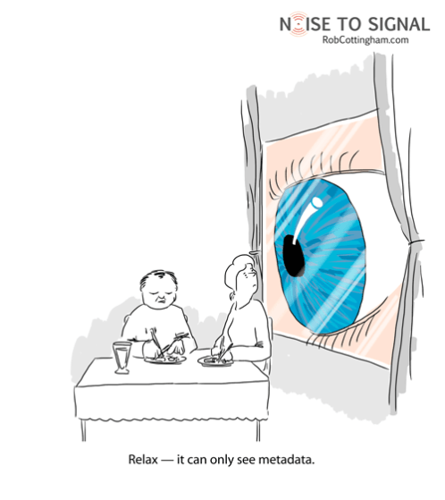
“Relax – it can only see metadata.”
Notes:
This is a cartoon I like by Rob Cottingham. I also like the caption.

Slide 10
Privacy of Statistical Data

Slide 11

Privacy in Statistical Databases
Individuals
Researchers
queries
“Agency”
answers
Large collections of personal information
census data
medical/public health
social networks
education
Statistical analysis benefits society
Valuable because they reveal so much about our lives
Notes:
This talk is about mostly about privacy. Privacy can mean many things.
I’ll talk about privacy in statistical databases. A good example to have in mind is the problem faced by the Census.
Imagine you have a server or agency---say the US Census bureau---that collects data from many individuals, and would like to make that data available, to the extent possible, for analysis by researchers.
The census can’t just publish its data – it is bound to keep responses confidential.
Collections of personal information are now ubiquitous.
Benefits to society to mining and having access to this data, especially in *aggregate*.
But what makes these data valuable is exactly what makes them sensitive, namely that they reveal many details about our lives.
So we really have a tension between two fundamental goals.

Slide 12
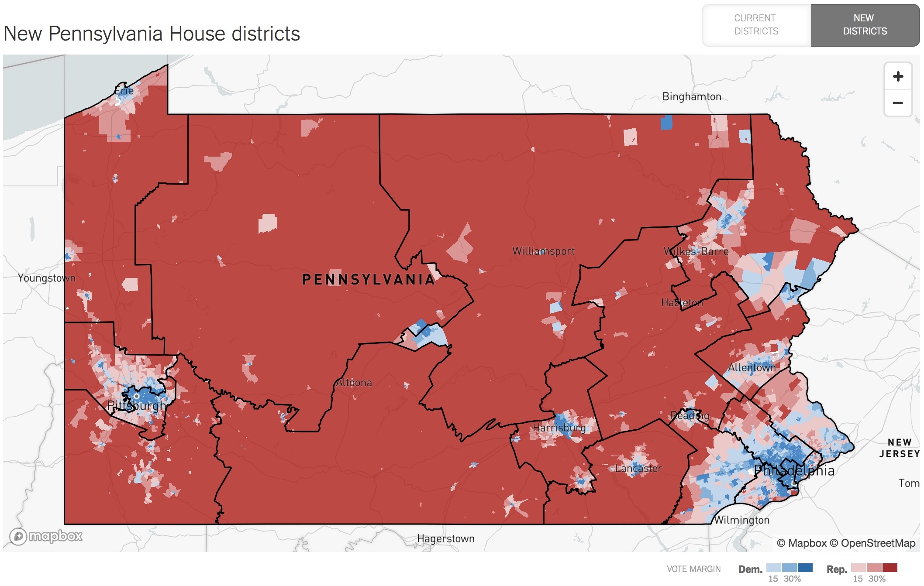
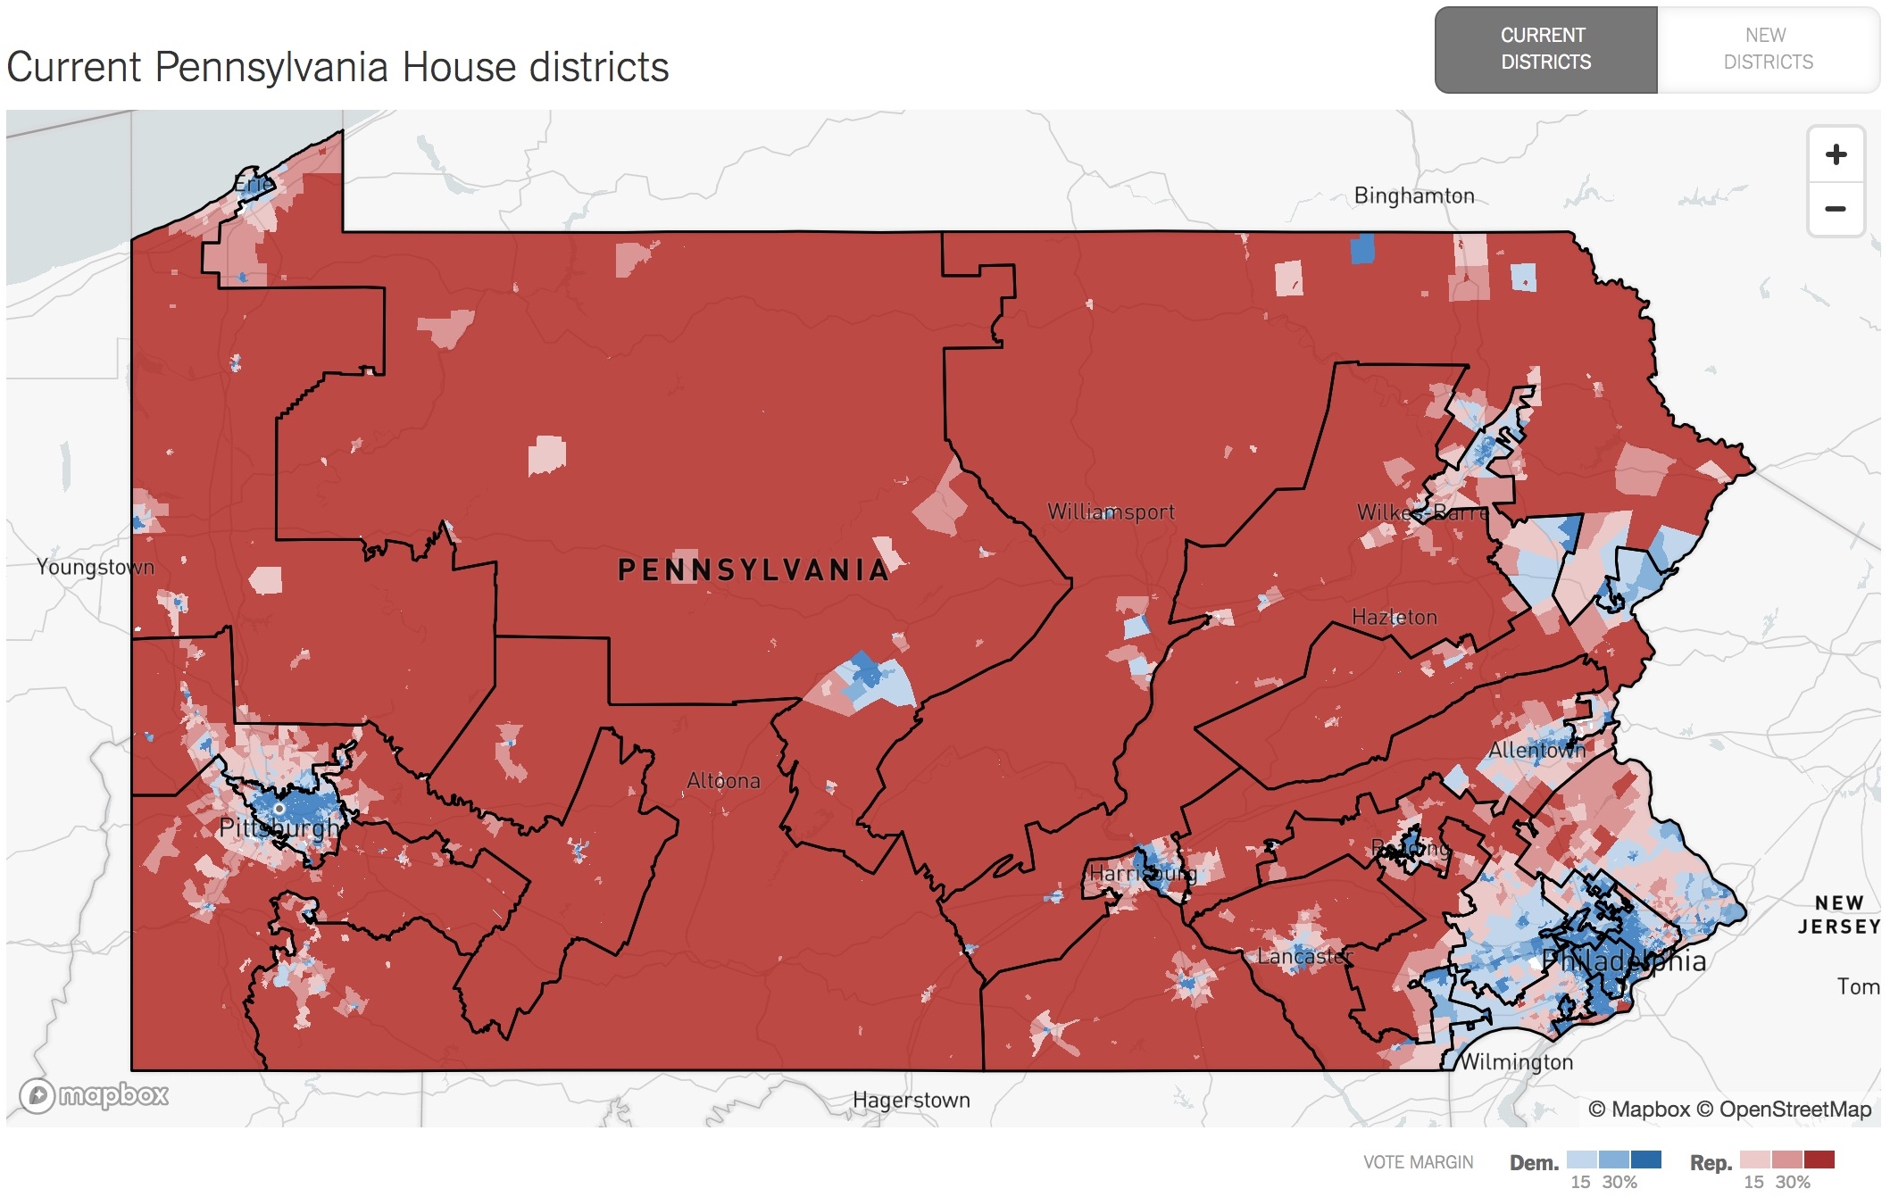

Slide 13
Two conflicting goals
Utility: release aggregate statistics
Privacy: individual information stays hidden
How do we define “privacy”?
Studied since 1960’s in
Statistics
Databases & data mining
Cryptography
This talk: Rigorous foundations and analysis
Utility
Privacy
Notes:
You might ask whether it’s too late for privacy. There is still time, and it is important.
We generate private data all the time. Questions of data privacy are tied to how we exercise basic rights like freedom of expression and association. And it suffices to imagine a life with no privacy at all to see just how important it is.

Slide 14
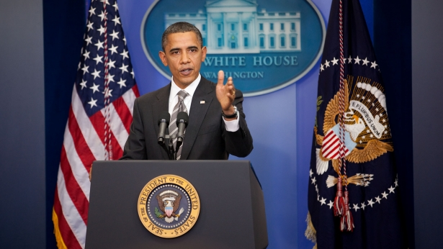
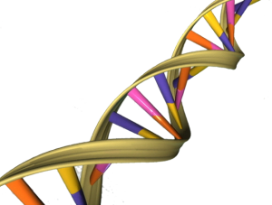
First attempt: Remove obvious identifiers
“AI recognizes blurred faces”
[McPherson Shokri Shmatikov ’16]
Name:
Ethnicity:
[Gymrek McGuire Golan Halperin Erlich ’13]
[Pandurangan ‘14]
Everything is an identifier
Attacker has external information
“Anonymization” schemes are regularly broken
Hospital A
Anonymize
Attacker
Hospital B
Anonymize
[Ganta Kasiviswanathan S ’08]
Images: whitehouse.gov, genesandhealth.org, medium.com
Notes:
It’s instructive to first think about the obvious strategy. If we want to make data available for broad use, why not just remove identifying information – things like names, social security numbers, and exact addresses, and publish what’s left?
The problem is, that doesn’t work. Consider the following photograph, where the subject’s face has been blurred. Most of us recognize him instantly, because there

Slide 15
The myth of PII
Example: FERPA (Family Educational Rights and Privacy Act) defines personally identifiable information:
“information that, alone or in combination, is linked or linkable to a specific student that would allow a reasonable person in the school community, who does not have personal knowledge of the relevant circumstances, to identify the student with reasonable certainty” (34 C.F.R. 99.3)
Similar requirements in HIPAA, and elsewhere
Come to Alexandra Wood’s Cyber Alliance talk (Spring)
Problem: PII-based distinctions either include everything or are meaningless

Slide 16
Is the problem granularity?
What if we only release aggregate information?
Statistics together may encode data
Example: Average salary before/after resignation
More generally:
Too many, “too accurate” statistics reveal individual information
Reconstruction attacks
Reconstruct all or part of data
Membership attacks
Determine if a target individual is in (part of) the data set
Cannot release everything everyone would want to know

Slide 17
Membership Attacks
[Homer et al. 2008] Exact high-dimensional summaries allow an attacker to test membership in a data set
Caused US NIH to change data sharing practices
[Dwork, Smith, Steinke, Ullman, Vadhan ‘15] Distorted high-dimensional summaries allow an attacker to test membership in a data set
[Shokri, Shmatikov 2017] Membership inference in “ML as a service”

Slide 18
[Shokri, Shmatikov 2017]

Slide 19
[Shokri, Shmatikov 2017]

Slide 20
[Shokri, Shmatikov 2017]

Slide 21
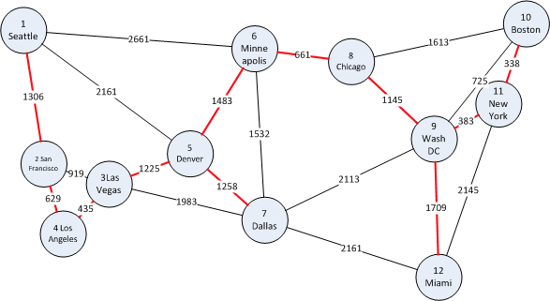
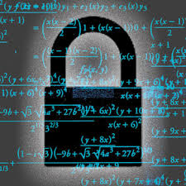
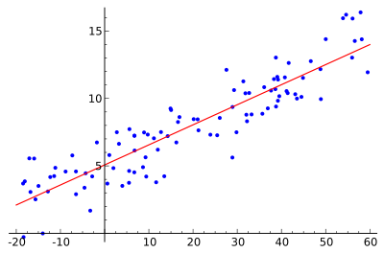
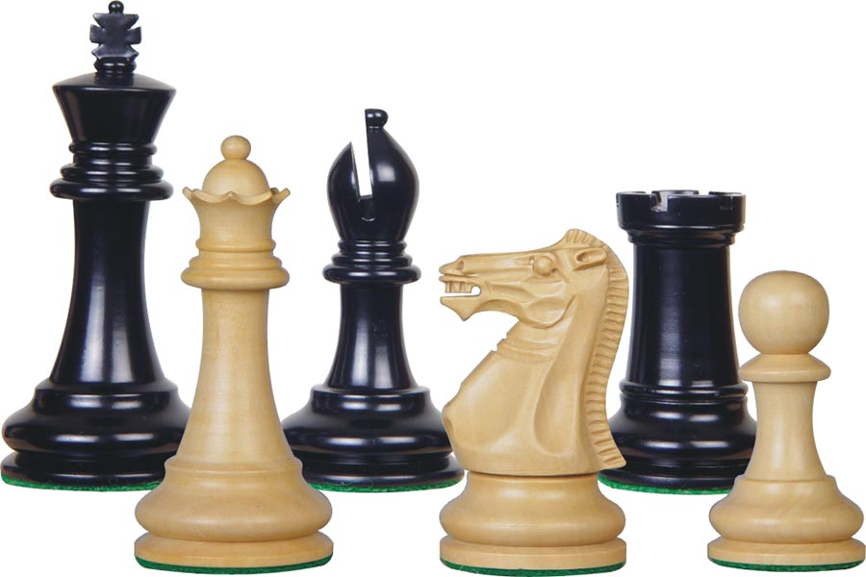
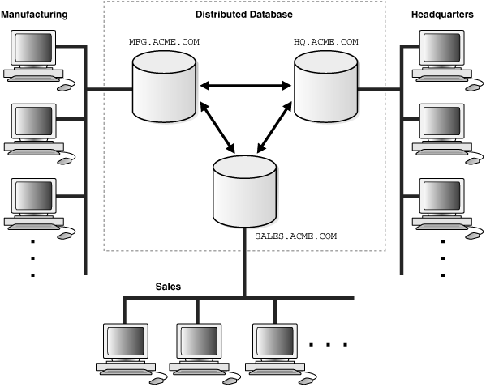

Differential privacy [Dwork, McSherry, Nissim, S ‘06]
Rigorous guarantees against arbitrary external information
In particular: resists known attacks
Burgeoning field of research
Crypto, security
Statistics, learning
Game theory, economics
Databases, programming languages
Law, policy
Algorithms

Slide 22
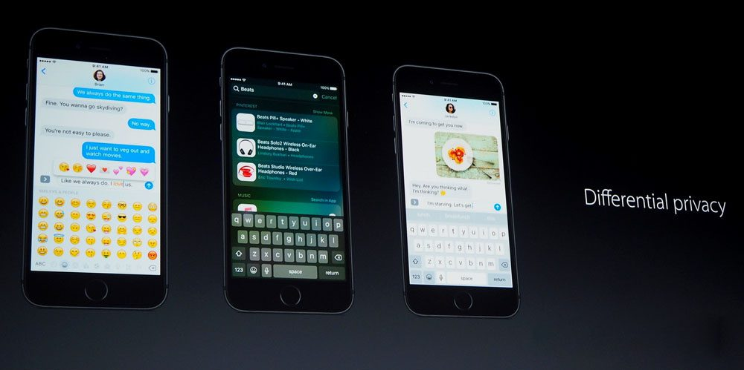

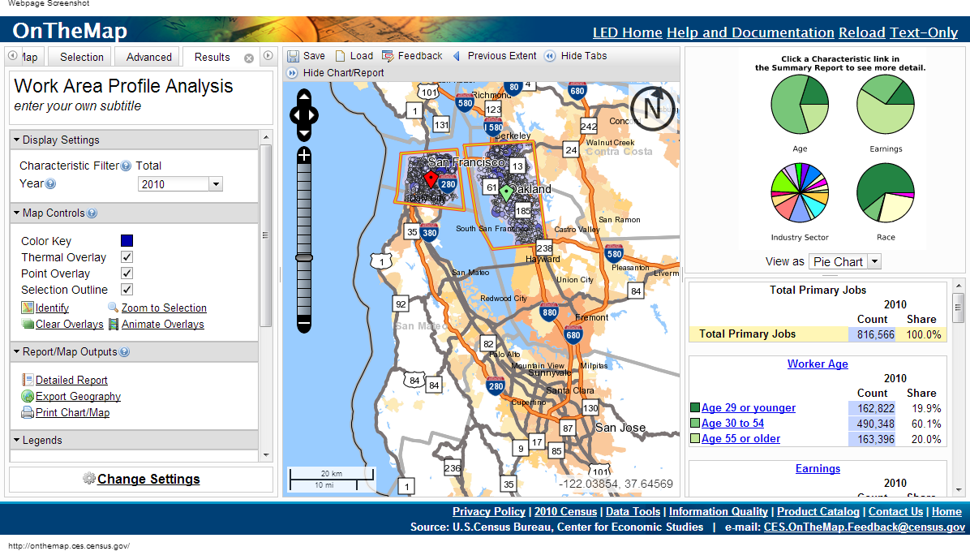
Deployed differentially private algorithms
https://developer.apple.com/videos/play/wwdc2016/709/
https://github.com/google/rappor
US Census Bureau (goal: full census in 2020)

Slide 23
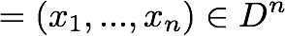
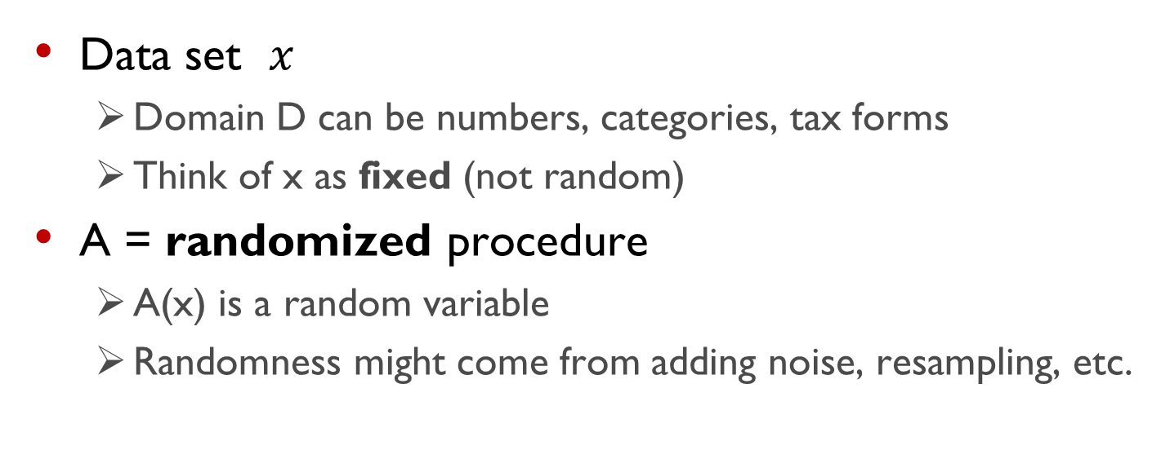
Differential Privacy [Dwork, McSherry, Nissim, S. 2006]
A
A(x)
local random coins
Data set $x$
Domain D can be numbers, categories, tax forms
Think of x as fixed (not random)
A = randomized procedure
A(x) is a random variable
Randomness might come from adding noise, resampling, etc.
Notes:
One of the insights is to define privacy in terms of the algorithm.

Slide 24
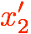
Differential Privacy
A
A(x)
A
A(x’)
local random coins
local random coins
A thought experiment
Change one person’s data (or add or remove them)
Will the distribution of outputs change much?
For any set of outcomes, about the same probability in both worlds

Slide 25
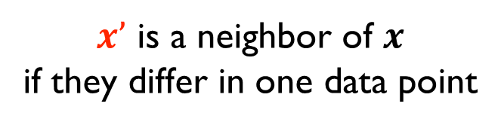
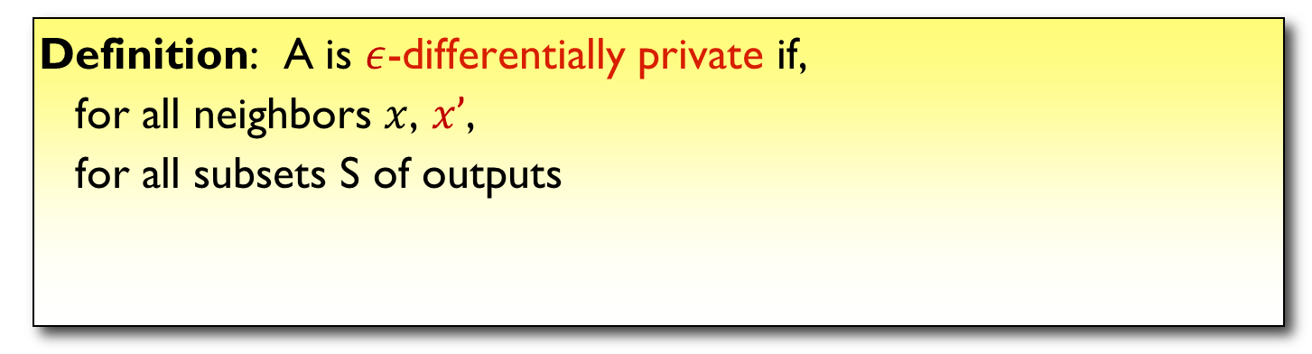
Differential Privacy [Dwork, McSherry, Nissim, S. 2006]
A
A(x)
A
A(x’)
local random coins
local random coins
$x’$ is a neighbor of $x$ if they differ in one data point
Neighboring databases induce close distributions on outputs
Definition: A is $ε$-differentially private if,
for all neighbors $x$, $x’$,
for all subsets S of outputs
Notes:
Say:
e^\eps is roughly (1+eps)
Same as requiring that probability distributions be off point for point by 1+eps.
This is a condition on the algorithm A
Saying a particular output is private makes no sense
Choice of distance measure matters
What is ε?
Measure of information leakage
Not too small (think , not )

Slide 26
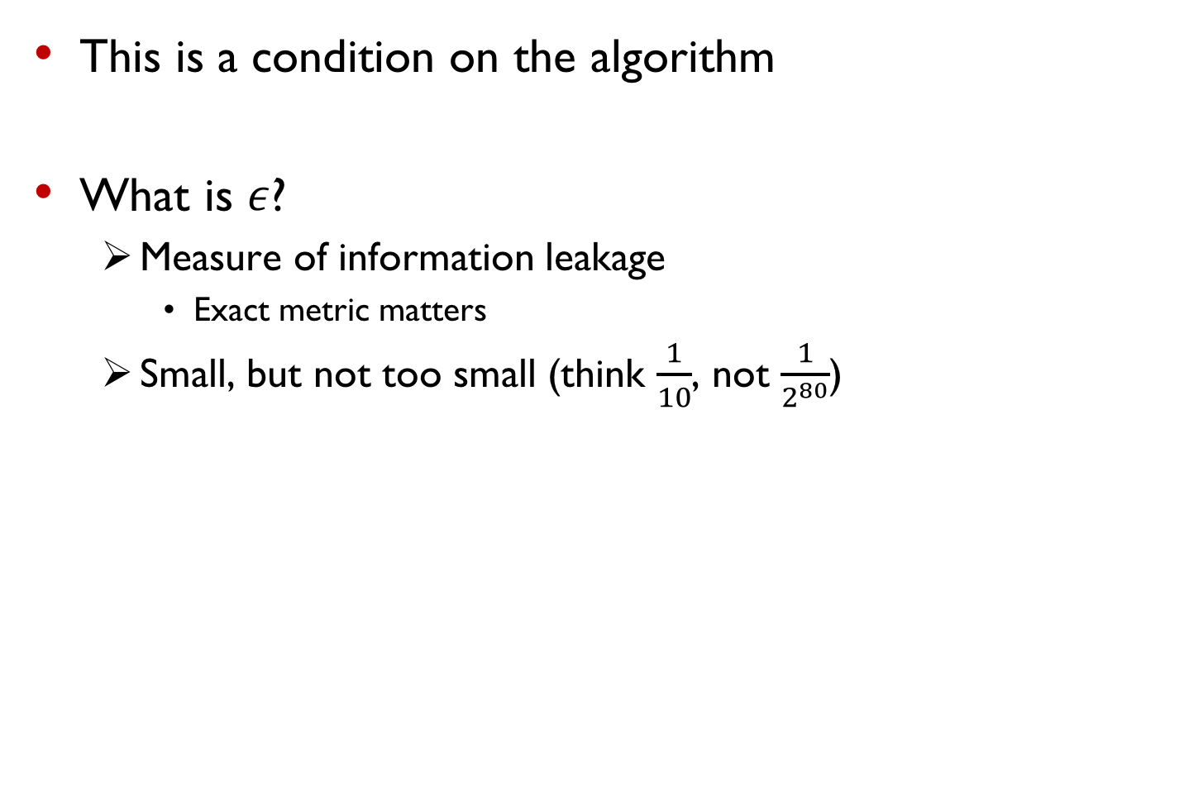
Differential Privacy [Dwork, McSherry, Nissim, S. 2006]
This is a condition on the algorithm
What is $ε$?
Measure of information leakage
Exact metric matters
Small, but not too small (think $\frac{1}{10}$, not $\frac{1}{2^{80}}$)
Neighboring databases induce close distributions on outputs
Definition: A is $ε$-differentially private if,
for all neighbors $x$, $x’$,
for all subsets S of outputs
Notes:
Say:
e^\eps is roughly (1+eps)
Same as requiring that probability distributions be off point for point by 1+eps.
This is a condition on the algorithm A
Saying a particular output is private makes no sense
Choice of distance measure matters
What is ε?
Measure of information leakage
Not too small (think , not )

Slide 27
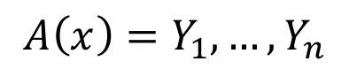
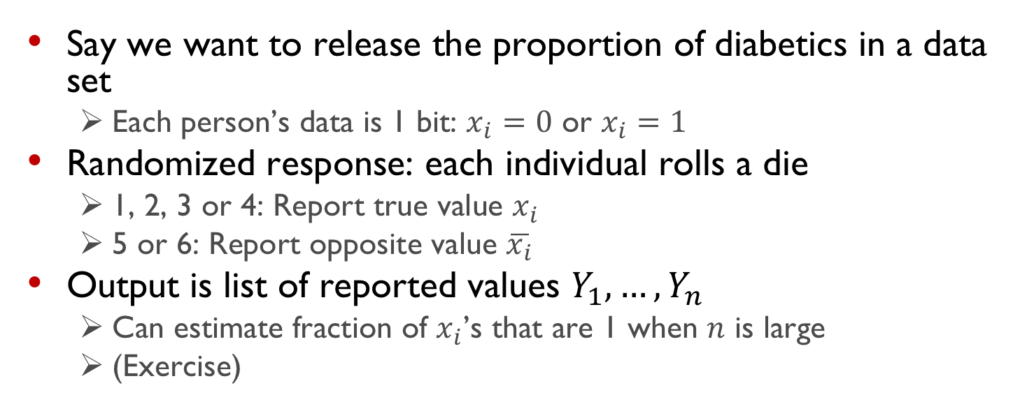
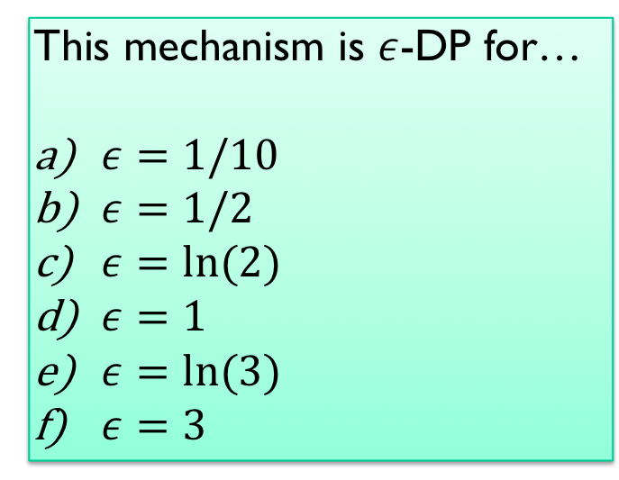
Randomized Response
This mechanism is $ε$-DP for…
$ε=1/10$
$ε=1/2$
$ε=ln⁡(2)$
$ε=1$
$ε=ln⁡(3)$
$ε=3$
A
$$A\left(x\right)=Y_{1},…,Y_{n}$$
local random coins
Say we want to release the proportion of diabetics in a data set
Each person’s data is 1 bit: $x_{i}=0$ or $x_{i}=1$
Randomized response: each individual rolls a die
1, 2, 3 or 4: Report true value $x_{i}$
5 or 6: Report opposite value $\overline{x_{i}}$
Output is list of reported values $Y_{1},…,Y_{n}$
Can estimate fraction of $x_{i}$’s that are 1 when $n$ is large
(Exercise)
Notes:
Intuition: $f(x)$ can be released accurately when $f$ is insensitive to individual entries $x_{1},…,x_{n}$

Slide 28
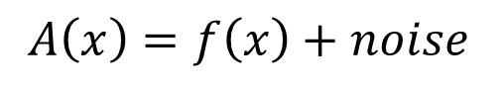
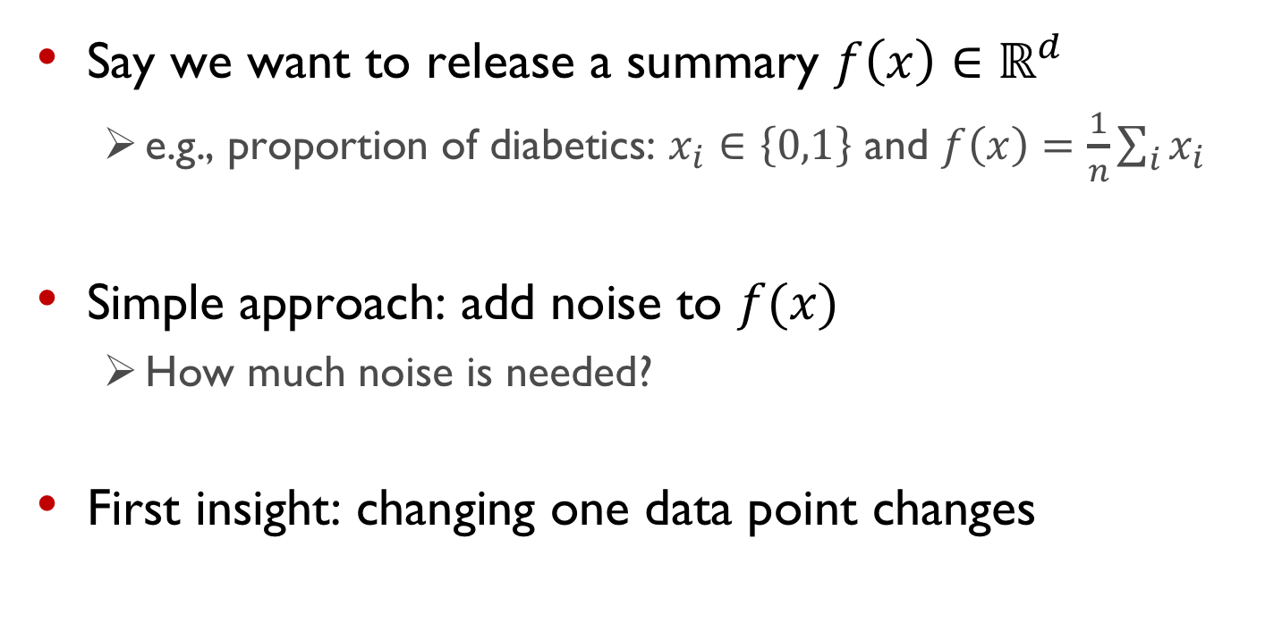
Noise Addition
function f
A
$$A\left(x\right)=f\left(x\right)+noise$$
local random coins
Say we want to release a summary $f\left(x\right)∈ℝ^{d}$
e.g., proportion of diabetics: $x_{i}∈\left\{0,1\right\}$ and $f\left(x\right)=\frac{1}{n}\sum_{i}{x_{i}}$
Simple approach: add noise to $f(x)$
How much noise is needed?
First insight: changing one data point changes
Notes:
Intuition: $f(x)$ can be released accurately when $f$ is insensitive to individual entries $x_{1},…,x_{n}$

Slide 29
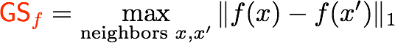
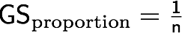
Noise addition
function f
A
$$A\left(x\right)=f\left(x\right)+noise$$
local random coins
Global Sensitivity:
Example:
f(x)
x
f(x’)
x’

Slide 30
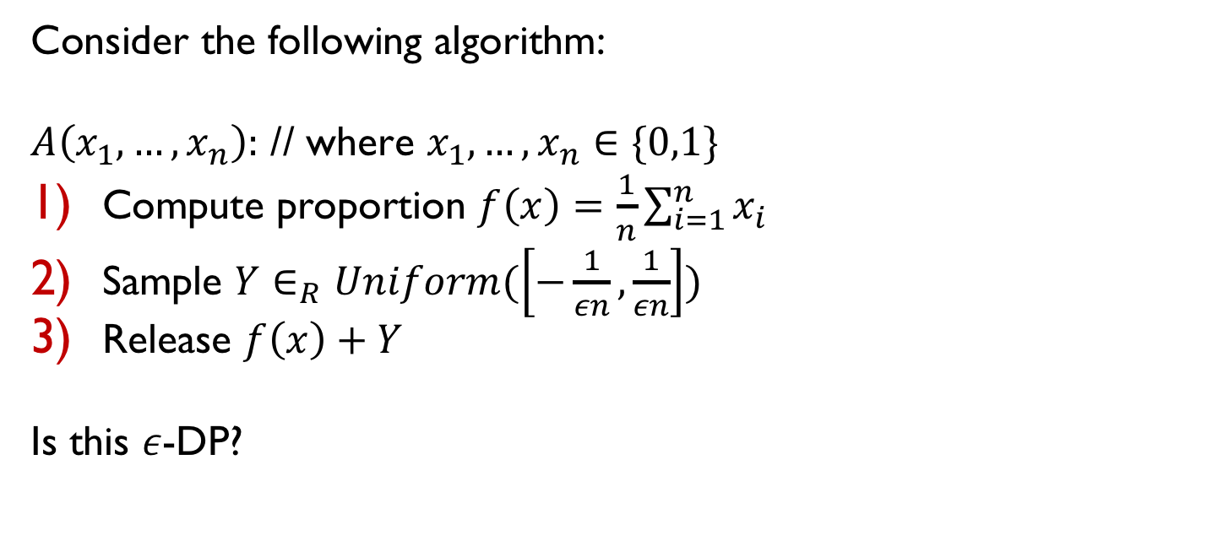
Noise Addition
function f
A
$$A\left(x\right)=f\left(x\right)+noise$$
local random coins
Consider the following algorithm:
$A\left(x_{1},…,x_{n}\right):$ // where $x_{1},…,x_{n}∈\{0,1\}$
Compute proportion $f\left(x\right)=\frac{1}{n}\sum_{i=1}^{n}{x_{i}}$
Sample $Y∈_{R}Uniform(\left[−\frac{1}{εn},\frac{1}{εn}\right])$
Release $f\left(x\right)+Y$
Is this $ε$-DP?
Notes:
Intuition: $f(x)$ can be released accurately when $f$ is insensitive to individual entries $x_{1},…,x_{n}$

Slide 31
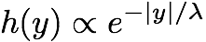
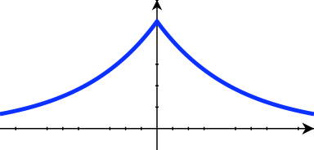
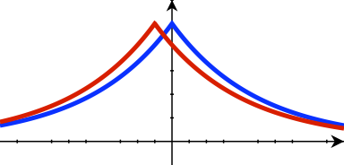
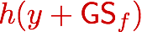
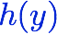
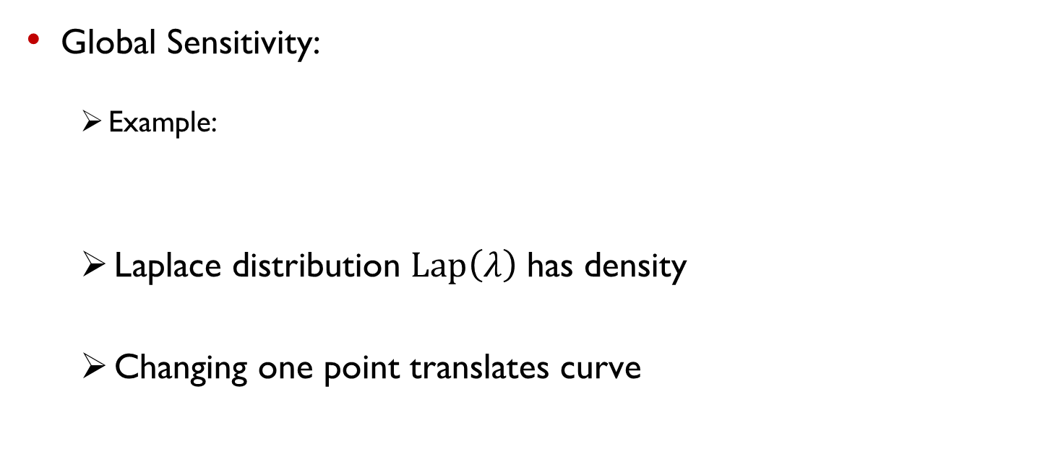
Laplace Mechanism
function f
A
$$A\left(x\right)=f\left(x\right)+noise$$
local random coins
Global Sensitivity:
Example:
Laplace distribution $Lap\left(λ\right)$ has density
Changing one point translates curve

Slide 32
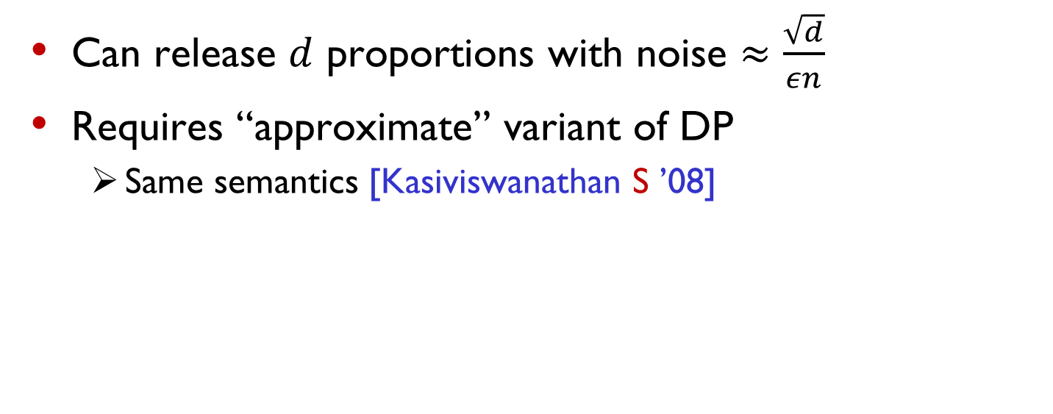
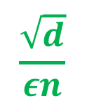
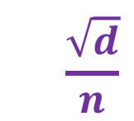
Attacks “match” differential privacy
function f
A
$$A\left(x\right)=f\left(x\right)+noise$$
local random coins
Can release $d$ proportions with noise $≈\frac{\sqrt{d}}{εn}$
Requires “approximate” variant of DP
Same semantics [Kasiviswanathan S ’08]
$$\frac{\sqrt{d}}{n}$$
$$\frac{\sqrt{d}}{εn}$$
Differential privacy
Known attacks
Notes:
Maybe just say:
maybe think DP is too conservative, but
in this basic setting it adds noise just above what attacks need.
Lots of algorithms other than noise addition, but noise addition most commonly used
What can we say about how much an attacker learns? External knowledge?

Slide 33
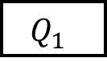
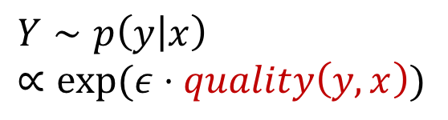
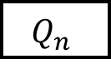
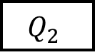
A rich algorithmic field
Noise addition
Exponential sampling
$Y∼p\left(y | x\right)$ $$∝exp(ε⋅quality\left(y,x\right))$$
$$Q_{1}$$
Local perturbation
Untrusted aggregator
$$Q_{2}$$
$$Q_{n}$$
A

Slide 34
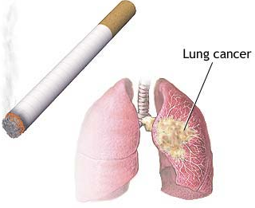
Interpreting Differential Privacy
A naïve hope:
Your beliefs about me are the same after you see the output as they were before
Impossible
Suppose you know that I smoke
Clinical study: “smoking and cancer correlated”
You learn something about me
Whether or not my data were used
Differential privacy implies: No matter what you know ahead of time,
You learn (almost) the same things about me whether or not my data are used
Bayesian formalization in [Kasiviswanathan S ’08]
Notes:
One can formalize this in several ways. I will present one way which I find most convincing.

Slide 35

Research on differential privacy
Definitions
Pinning down “privacy”
Algorithms: what can we compute privately?
Fundamental techniques
Specific applications
Systems: How do you design systems that guarantee DP?
PL, DBMS, …
Attacks: “Cryptanalysis” for data privacy
Impossibility results
Implications for other areas
Adaptive data analysis
Notes:
One of the most striking aspects of a academic career is the feeling that “I can’t believe people actually pay me to do this”. So here are a few organizations that support my research.

Slide 36
Privacy as control

Slide 37
Secrecy v. Control
Sometimes privacy = secrecy
Attorney-client privilege
Dressing out of sight
Subversive speech
Sometimes, “privacy” = control
Sharing medical records
Dressing/undressing
Discussing suicidal thoughts
Information gathered by amazon to
Fulfill an order
Recommend me products
Sell to other companies
Information gathered by government for
Census
Surveillance
”Privacy” deeply tied to basic rights

Slide 39
Fairness and bias

Slide 40
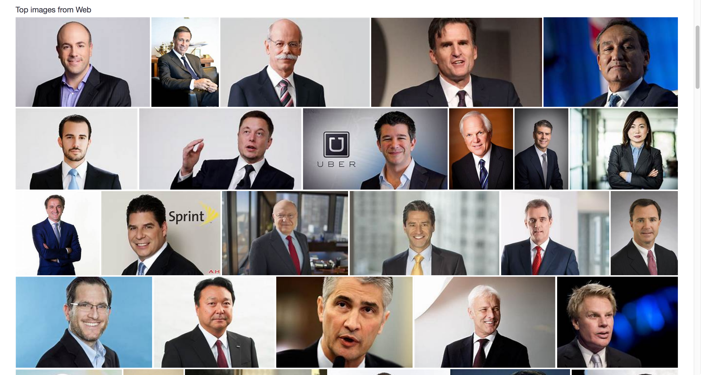
Algorithmic bias
Search images.yahoo.com for “CEO”

Slide 41
Further Reading
Data Ethics (in general)
Lachlan McCalman. Ethics by numbers: how to build machine learning that cares (2017)
https://theconversation.com/ethics-by-numbers-how-to-build-machine-learning-that-cares-85399
Privacy
Z. Tufecki
https://www.nytimes.com/2018/03/19/opinion/facebook-cambridge-analytica.html
https://www.nytimes.com/2018/01/30/opinion/strava-privacy.html
A. Narayanan and V. Shmatikov, Myths and fallacies of “Personally identifiable information” (2010)
https://www.cs.utexas.edu/~shmat/shmat_cacm10.pdf
Nissim et al, Differential Privacy: A Primer for a Non-technical Audience, (2018)
https://privacytools.seas.harvard.edu/files/privacytools/files/pedagogical-document-dp_new.pdf
Transparency
Simonite, AI Experts Want To End 'Black Box' Algorithms In Government. Wired, 2017
https://www.wired.com/story/ai-experts-want-to-end-black-box-algorithms-in-government/
How to hold algorithms accountable, MIT Tech Review
https://www.technologyreview.com/s/602933/how-to-hold-algorithms-accountable/
New York City commission on algorithmic accountability
https://www.newyorker.com/tech/elements/new-york-citys-bold-flawed-attempt-to-make-algorithms-accountable
Fairness
Propublica and Compas:
https://www.propublica.org/article/machine-bias-risk-assessments-in-criminal-sentencing

